Slide 1
Propositional Logic:
A (relatively) simple, formal approach to knowledge representation and inference
Outline:
Review of propositional logic terminology
Proof by perfect induction
Proof by Wang’s algorithm
Proof by resolution

Slide 2
Role of Logical Inference in AI
The single most important inference method.
But:
Doesn't handle uncertain information well.
Needs algorithmic help – prone to the combinatorial explosion.

Slide 3
Brief Introduction/Review:
Propositional Calculus
Note that the propositional calculus
provides a foundation for the more powerful
predicate calculus which is very important
in AI and which we will study later.

Slide 4
A Logical Syllogism
If it is raining, then I am doing my homework.
It is raining.
Therefore, I am doing my homework.

Slide 5
Another Syllogism
It is not the case that steel cannot float.
Therefore, steel can float.

Slide 6
Terminology of the Propositional Calculus
Proposition symbols:
P, Q, R, P₁, P₂, ... , Q₁, Q₂, ..., R₁, R₂, ...
Atomic proposition: a statement that does not specifically contain substatements.
P: “It is raining.”
Q: “Neither did Jack eat nor did he drink.”
Compound proposition: A statement formed from one or more atomic propositions using logical connectives.
P v Q: Either it is raining, or neither did Jack eat nor did he drink.

Slide 7
Logical Connectives
Negation: ¬P not P
Conjunction: P ∧ Q P and Q
Disjunction: P v Q P or Q
Exclusive OR: P <> Q P exclusive-or Q

Slide 8
Logical Connectives (Cont)
NAND: ¬(P ∧ Q) P nand Q
NOR: ¬(P v Q) P nor Q
Implies: P → Q if P then Q
¬P v Q

Slide 9
Logically Complete Sets of Connectives
{¬, v} form a logically complete set.
P ∧ Q = ¬(¬P v ¬Q)
{¬, →} form a logically complete set
P ∧ Q = ¬(P → ¬Q)
{¬, ∧} form a logically complete set
P v Q = ¬(¬P ∧ ¬Q)

Slide 10
Syllogism: General Form
Premise 1
Premise 2
...
Premise n
--------------
Conclusion
P₁ ∧ P₂ ∧ ... ∧ P_{n} → C

Slide 11
Modus Ponens: An important rule of inference
P → Q conditional
P antecedent
---------
Q consequent
aka the “cut rule”

Slide 12
Modus Tollens:
(modus ponens in reverse)
P → Q conditional
¬Q consequent denied
---------
¬P antecedent denied
Can be proved using “transposition” – taking the contrapositive of the conditional:
P → Q ⇔ ¬Q → ¬P
¬Q
therefore, by modus ponens, ¬P

Slide 13
Algorithms for Logical Inference
Issues:
Goal-directed or not?
Always exponential in time? Space?
Intelligible to users?
Readily applicable to problem solving?

Slide 14
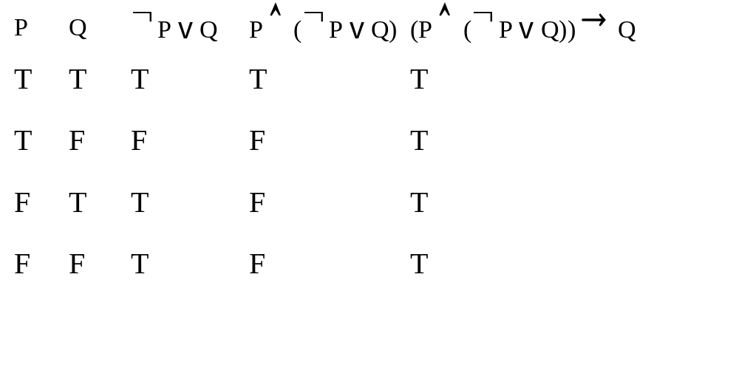
Proof by Perfect Induction
Prove that P, ¬P v Q ⇒ Q

Slide 15
Perfect Induction: The process
Express the syllogism as a conditional expression of the form P₁ ∧ P₂ ∧ ... ∧ P_{n} → C
Create a table with one column for each variable and each subexpression occurring in the formula
Create one row for each possible assignment of T and F to the variables
Fill in the entries for variables with all combinations of T and F.
Fill in the entries for other subexpressions by evaluating them with the corresponding variable values in that row.

Slide 16
Perfect Induction: The process (cont)
If the column for the overall syllogism has T in every row, then the syllogism is valid; otherwise it’s not valid.
Alternatively, identify all rows in which all premises are true, and then check to see whether the conclusion in those rows is also true. If the conclusion is true in all those rows, then the syllogism is valid; otherwise, it is not valid.

Slide 17
Perfect Induction: Characteristics
Goal-directed (compute only columns of interest)
Always exponential in time AND space
Somewhat understandable to non-technical users
Straightforward algorithmically
Not considered appropriate for general problem solving.

Slide 18
Another Strategy: Use Gradual Simplification Plus Divide-and-Conquer
A method called Wang’s algorithm works backwards from the syllogism to be proved, gradually simplifying the goal(s) until they are either reduced to axioms or to obviously unprovable formulas.

Slide 19
Proof by Wang’s Algorithm
Write the hypothesis as a “sequent” of form X ⇒ Y.
(Eliminate →)
Place the premises on the left-hand side separated by commas, and place the conclusion on the right hand side.
1. (P ∧ (¬P v Q)) ⇒ Q.
2. P, ¬P v Q ⇒ Q.
3a. P, ¬P ⇒ Q; 3b. P, Q ⇒ Q.
4a. P ⇒ Q, P;

Slide 20
Wang’s Method (Cont.)
Transform each sequent until it is either an “axiom” and is proved, or it cannot be further transformed.
Note: Each rule removes one instance of a logical connective.
And on the left: X, A ∧ B, Y ⇒ Z
becomes X, A, B, Y ⇒ Z
Or on the right: X ⇒ Y, A v B, Z
becomes X ⇒ Y, A, B, Z
Not on the left: X, ¬A, Y ⇒ Z becomes X, Y ⇒ Z, A
Not on the right: X ⇒ Y, ¬A, Z becomes X, A ⇒ Y, Z

Slide 21
Wang’s Method (Cont.)
Or on the left: X, A v B, Y ⇒ Z
becomes X, A, Y ⇒ Z; X, B, Y ⇒ Z.
And on the right: X ⇒ Y, A ∧ B, Z
becomes X ⇒ Y, A, Z; X ⇒ Y, B, Z.
In a split, both of the new sequents must be proved.
Axiom: A sequent in which any proposition symbol
occurs at top level on both the left and right sides.
e.g., P, P v ¬Q ⇒ P

Slide 22
Wang's Method: Characteristics
Goal directed (begin with sequent to be proved)
Sometimes exponential in time. Relatively space-efficient.
Somewhat mysterious to non-technical users
Algorithmically simple but more complex than perfect induction.
Not considered appropriate for general problem solving.

Slide 23
Resolution
An inference method called “resolution” is probably the most important one for logic programming and automatic theorem proving.
Resolution can be considered as a generalization of modus ponens.
It becomes very powerful in the predicate calculus when combined with a substitution technique known as “unification.”
In order to use resolution, our logical formulas must first be converted to “clause form.”

Slide 24
Clause Form
Expressions such as P, ¬P, Q and ¬Q are called literals.
They are atomic formulas to which a negation may be prefixed.
A clause is an expression of the form L₁ v L₂ v ... v L_{q}
where each L_{i} is a literal.
Any propositional calculus formula can be represented as a set of clauses.
¬(P ∧ (Q → R)) starting formula
¬(P ∧ (¬Q v R)) eliminate →
¬((P ∧ ¬Q) v (P ∧ R)) distribute ∧ over v.
¬(P ∧ ¬Q) ∧ ¬(P ∧ R) DeMorgan’s law
(¬P v ¬ ¬Q) ∧ (¬P v ¬R) “ “
¬P v Q, ¬P v ¬R Double neg. and break into clauses

Slide 25
Propositional Resolution
Two clauses having a pair of complementary literals can be resolved to produce a new clause that is logically implied by its parent clauses. (Here are four separate examples.)
e.g. Q v ¬R v S, R v ¬P ⇒ Q v S v ¬P
P v Q, ¬Q v R ⇒ P v R
P, ¬P v R ⇒ R
P, ¬P ⇒ [] (the null clause)

Slide 26
Reductio ad Absurdum
A proof by resolution uses RAA (proof by contradiction).
Original syllogism:
Premise 1
Premise 2
...
Premise n
---------------
Conclusion
Syllogism for RAA:
Premise 1
Premise 2
...
Premise n
¬Conclusion
----------------------
[]

Slide 27
Example Proof Using Resolution
Prove: (P → Q) ∧ (Q → R) ⇒ (P → R)
This happens to be named “hypothetical syllogism”
Negate the conclusion:
(P → Q) ∧ (Q → R) ⇒ ¬(P → R)
Obtain clause form:
¬P v Q, ¬Q v R, P, ¬R.
Derive the null clause using resolution:
Q resolving P with ¬P v Q.
R resolving Q with ¬Q v R.
F resolving R with ¬R.

Slide 28
Resolution: Characteristics
Not necessarily goal directed (can be used in either forward-chaining or backward-chaining systems).
Time and space requirements depend on the algorithm in which resolution is embedded.
Can be made understandable to non-technical users
Needs to be combined with a search algorithm.
Can be very appropriate for general problem solving (e.g., using PROLOG)

